Slide 1
Impact of Annual Hospital Procedure Volume on Outcomes after Percutaneous Ventricular Assist Device Implantation
Gunsagar Gulati
David Ouyang
Richard Ha
Dipanjan Banerjee

Slide 2
 | Low volume/year | Medium volume/year | High volume/year
Number of hospitals | 439 | 117 | 47
Number of PVAD | 762 | 768 | 763
PVAD volume/year, median (1st, 3rd) | 1 (1, 2) | 5 (4, 6) | 11 (9.5, 15.5)
Percent mortality n (%) | 239 (31.4) | 214 (27.9) | 201 (26.3)

Slide 3
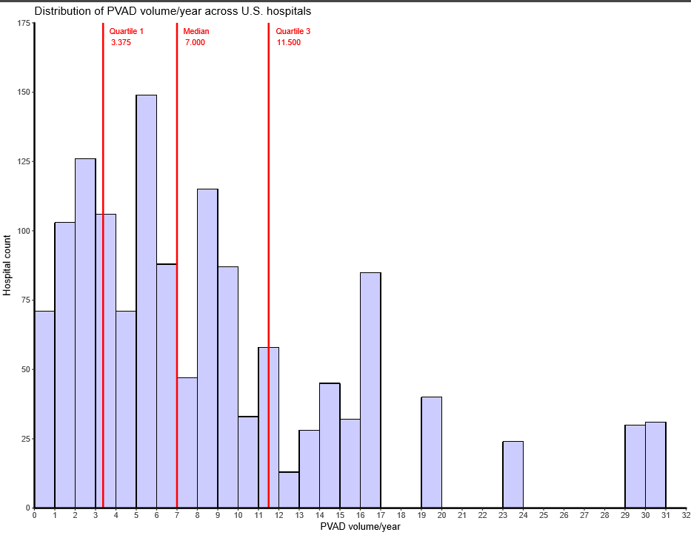

Slide 4
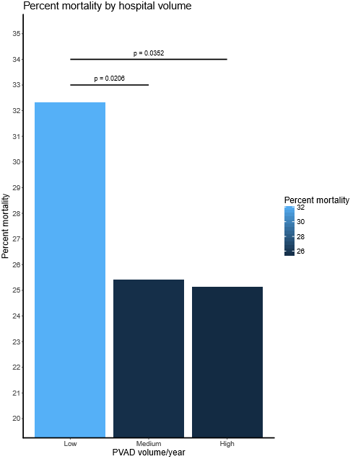

Slide 5
Table 1. Baseline demographics of patients who received percutaneous ventricular assist devices (PVADs) in low, medium, and high volume hospitals between 2004 and 2011
 | Low volume/year n = 362 | Medium volume/year n = 696 | High volume/year n = 386 | p-value
In-hospital mortality (%) | 32.3 | 25.4 | 25.1
Length of stay, mean ± SD | 10.6 ± 12.8 | 13.3 ± 15.8 | 14.2 ± 15.0
Age, mean ± SD | 65.2 ± 13.7 | 64.0 ± 14.2 | 65.0 ± 14.1
Sex, n (%)
Male | 260 (71.8) | 520 (74.1) | 277 (71.8)
Female | 102 (28.2) | 166 (23.9) | 109 (28.2)
Race, n (%)
White | 213 (58.8) | 448 (64.4) | 197 (51.0)
Black | 39 (10.8) | 47 (6.8) | 58 (15.0)
Hispanic | 31 (8.6) | 40 (5.7) | 34 (8.8)
Asian/Pacific Islander | 2 (0.6) | 20 (2.9) | 8 (2.1)
Native American | 2 (0.6) | 8 (1.1) | 1 (0.3)
Other or unknown | 75 (20.7) | 133 (19.1) | 88 (22.8)
Median household income, n (%)
$1-24,999 | 97 (26.8) | 175 (25.1) | 152 (39.4)
$25,000-34,999 | 75 (20.7) | 180 (25.9) | 80 (20.7)
$35,000-44,999 | 95 (26.2) | 168 (24.1) | 69 (17.9)
$45,000 or more | 85 (23.5) | 156 (22.4) | 76 (19.7)
Unknown | 10 (2.8) | 17 (2.4) | 9 (2.3)
Year of hospitalization, n (%)
2004 | 3 (0.8) | 0 (0.0) | 0 (0.0)
2005 | 17 (4.7) | 18 (2.6) | 0 (0.0
2006 | 19 (5.2) | 7 (1.0) | 0 (0.0)
2007 | 16 (4.4) | 15 (2.2) | 0 (0.0)
2008 | 41 (11.3) | 33 (4.7) | 45 (11.7)
2009 | 78 (21.5) | 187 (26.9) | 29 (7.5)
2010 | 96 (26.5) | 178 (25.6) | 78 (20.2)
2011 | 92 (25.4) | 258 (37.1) | 234 (60.6)
Region of hospital, n (%)
Northeast
Midwest
South
West
Unknown
Location of hospital, n (%)
Rural
Urban
Unknown
Bedsize of hospital, n (%)
Small
Medium
Large
Unknown
Teaching status of hospital, n (%)
Nonteaching
Teaching
Unknown

Slide 6
Table 2. Comorbidities of patients who received percutaneous ventricular assist devices (PVADs) in low, medium, and high volume hospitals between 2004 and 2011
 | Low volume/year n = 362 | Medium volume/year n = 696 | High volume/year n = 386 | p-value
Ischemic cardiomyopathy | 263 (72.7) | 504 (72.4) | 292 (75.6)
Chronic Ischemic Heart Disease | 250 (69.1) | 476 (68.4) | 268 (69.4)
Hypertension | 184 (50.8) | 341 (49.0) | 197 (51.0)
Acute Myocardial Infarction | 160 (44.2) | 325 (46.7) | 191 (49.5)
Diabetes | 112 (30.9) | 223 (32.0) | 118 (30.6)
Renal Dysfunction | 62 (17.1) | 149 (21.4) | 84 (21.8)
Peripheral vascular disease | 28 (7.7) | 71 (10.2) | 40 (10.4)
History of CABG | 19 (5.2) | 36 (5.2) | 24 (6.2)
History of other cardiac surgery | 0 (0.0) | 0 (0.0) | 0 (0.0)

Slide 7
Table 3. Complications in patients who received percutaneous ventricular assist devices (PVADs) in low, medium, and high volume hospitals between 2004 and 2011
 | Low volume/year n = 362 | Medium volume/year n = 696 | High volume/year n = 386 | p-value
Bleeding | 63 (17.4) | 128 (18.4) | 84 (21.8)
Renal | 32 (8.8) | 70 (10.1) | 39 (10.1)
Cardiac | 25 (6.9) | 69 (9.9) | 35 (9.1)
Mechanical | 26 (7.2) | 51 (7.3) | 30 (7.7)
Infectious | 1 (0.3) | 2 (0.3) | 2 (0.5)
Thromboembolic | 2 (0.6) | 0 (0.0) | 0 (0.0)
Respiratory | 0 (0.0) | 0 (0.0) | 0 (0.0)

Slide 8
Table 4. Multivariate predictors of mortality after PVAD implantation from 2004-2011 (n = 1444)
 | Odds Ratio | 95% Confidence Interval | p-value
Demographic predictors
Age 65 or older | 0.65 | 0.52-0.82 | < 0.001
Female gender | 1.17 | 0.90-1.52 | 0.229
White/Caucasian race | 0.78 | 0.62-0.98 | 0.037
Median houshold income less than $25,000 | 0.94 | 0.73-1.21 | 0.621
Procedure year 2008 or later | 1.33 | 0.81-2.19 | 0.259
Comorbidity predictors
Acute myocardial infarction | 1.25 | 0.99-1.58 | 0.058
Hypertension | 0.51 | 0.40-0.64 | < 0.001
Diabetes | 0.53 | 0.40-0.69 | <0.001
Renal dysfunction | 0.70 | 0.51 -0.94 | 0.02
Ischemic heart disease | 0.39 | 0.31 - 0.50 | <0.001
History of coronary artery bypass graft (CABG) | 0.47 | 0.25-0.87 | 0.014
Peripheral vascular disease | 0.4 | 0.24-0.65 | <0.001
Complication predictors
Bleeding | 1.83 | 1.39-2.42 | <0.001
Renal | 2.48 | 1.74-3.54 | <0.001
Cardiac | 1.94 | 1.34-2.82 | <0.001
Mechanical | 6.56 | 4.30-10.02 | <0.001
Hospital predictors
Northeast region
Rural location
Small bedsize
Teaching
Low PVAD procedure volume | 1.41 | 1.09-1.82 | 0.010

